Slide 1
The Text-to-Speech Converter Using Python
SUBJECT: MINI PROJECT
DHVANI UPADHYAY_92400588015
DIYA SHAH_92400588063
PRAGATIBA CHUDASAMA_92400588044

Slide 2
Introduction:
Text-to-Speech (TTS) is a technology that converts written text into spoken voice.
This project is developed using the Python programming language.
The user enters text through the keyboard.
The program converts the entered text into speech and plays it through the computer speaker.
The project uses the pyttsx3 library to perform the conversion.

Slide 3
Objectives:
To develop a simple Text-to-Speech Converter using Python.
To convert user-entered text into spoken voice.
To understand the use of the pyttsx3 library.
To learn how to control speech speed and volume.
To develop a simple interactive Python application.

Slide 4
Tools & Technologies Used:
Tool / Technology | Purpose
Python | Programming language
pyttsx3 | Converts text into speech
VS Code / IDLE | Used to write and run the program
Keyboard | Used to enter text
Computer Speaker | Used to hear the generated speech

Slide 5
Working of the Project:
The project works in the following steps:
1. Initialize the program
The pyttsx3 library is imported and the speech engine is initialized.
2. Set speech properties
The program sets the speech rate and volume.
3. Take user input
The user enters the text they want to hear.
4. Check the input
The program checks whether the user has entered empty text.
5. Convert text into speech
The engine.say() function sends the entered text to the speech engine.
6. Play the speech
The engine.runAndWait() function processes and plays the speech.
7. Continue or exit
The program asks whether the user wants to convert another text

Slide 6
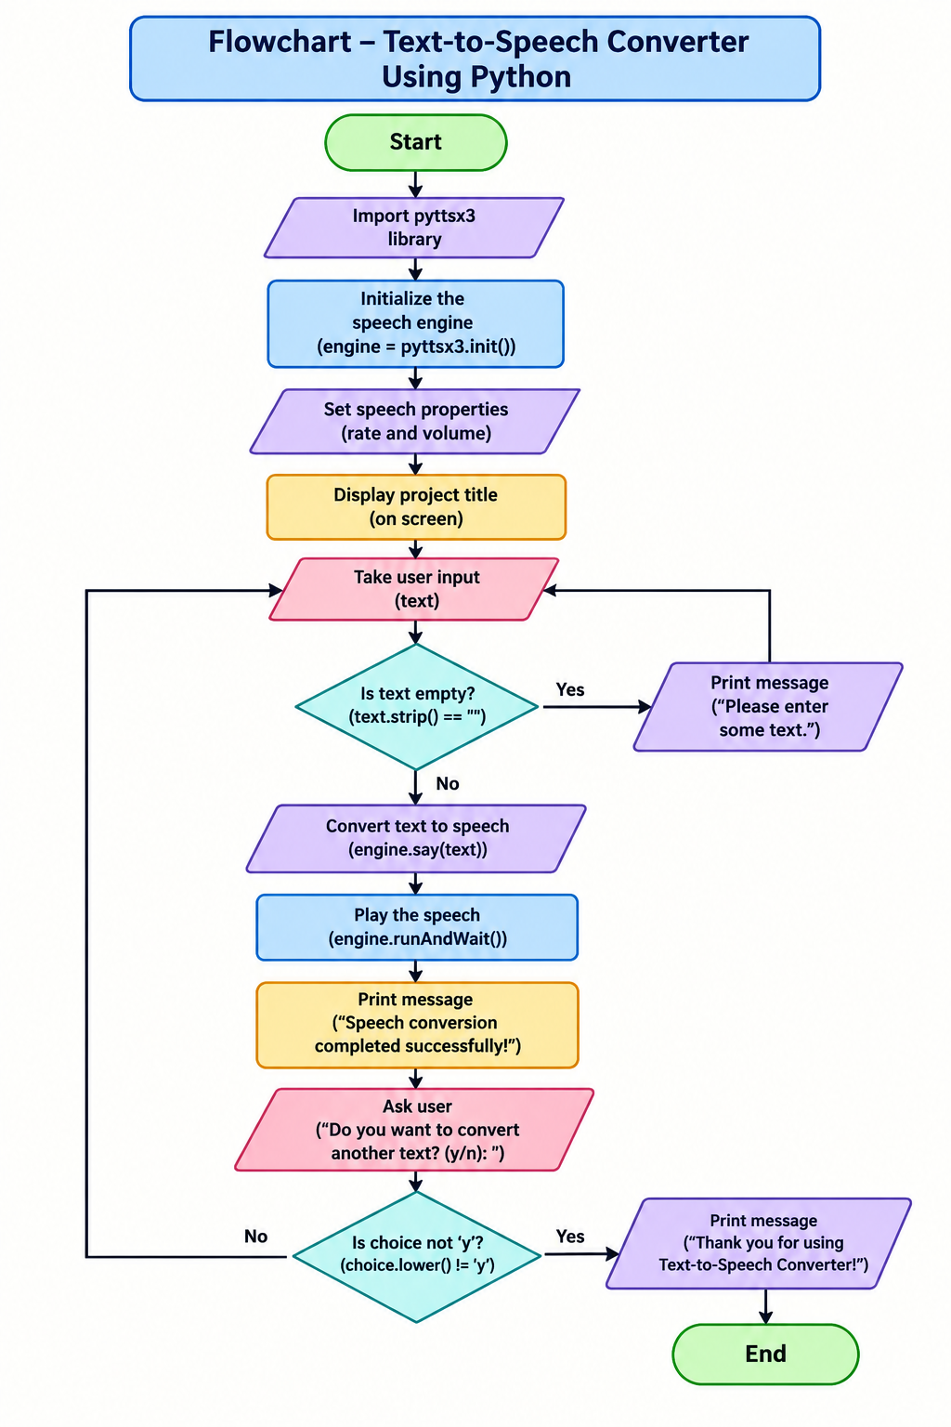
Flowchart:

Slide 7
Future Enhancements:
The project can be improved in the future by:
Adding a Graphical User Interface (GUI).
Adding different voice options.
Adding multiple language support.
Allowing users to change speech speed and volume through buttons/sliders.
Adding an option to save speech as an audio file.
Making the application more attractive and user-friendly.

Slide 8
Conclusion:
he Text-to-Speech Converter successfully converts written text into spoken voice
Python and the pyttsx3 library make the implementation simple.
The project demonstrates important Python concepts such as input, conditions, loops, variables, and library functions.
It provides a simple and useful application of Text-to-Speech technology.

Slide 9
Bibliography:
Python Programming Documentation
pyttsx3 Documentation
Python Programming Classroom Notes

